Slide 1
Computer Networks
Link Layer - Flow Control Protocols
& HDLC
S.V.Jansi Rani
Associate Professor / CSE

Slide 2
Agenda
Link Layer Services
Flow Control Protocol
Byte and Bit Stuffing
HDLC
Frames - I , S, U
Frame formats

Slide 3



Slide 4
FRAMING
The data link layer needs to pack bits into frames, so that each frame is distinguishable from another.
Postal system - letter into an envelope ,the envelope serves as the delimiter.

Slide 5
FRAMING
The whole message - packed in one frame, not done
Frame - very large
FC , EC - inefficient
Large frame - single-bit error needs retransmission of the whole frame. But smaller frame .....

Slide 6
FRAMING
Fixed-size framing
In fixed-size framing- no boundaries of the frames
Size itself can be used as a delimiter. Eg:- ATM WAN, which uses frames of fixed size called cells
Variable-size framing
To define the end of one frame and the beginning of the nex
Two approaches
Character-oriented approach
Bit-oriented approach

Slide 7
CHARACTER ORIENTED FRAMING
Data to be carried are 8-bit characters from a coding system such as ASCII
Header - source and destination addresses, control information, and the trailer - error detection redundant bits, are also multiples of 8 bits.
To separate one frame from the next, an 8-bit (1-byte) flag (special characters) is added at the beginning and theend of a frame.

Slide 8
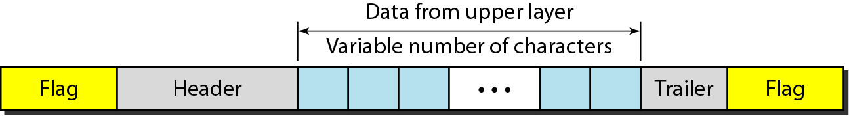
A frame in a character-oriented protocol

Slide 9
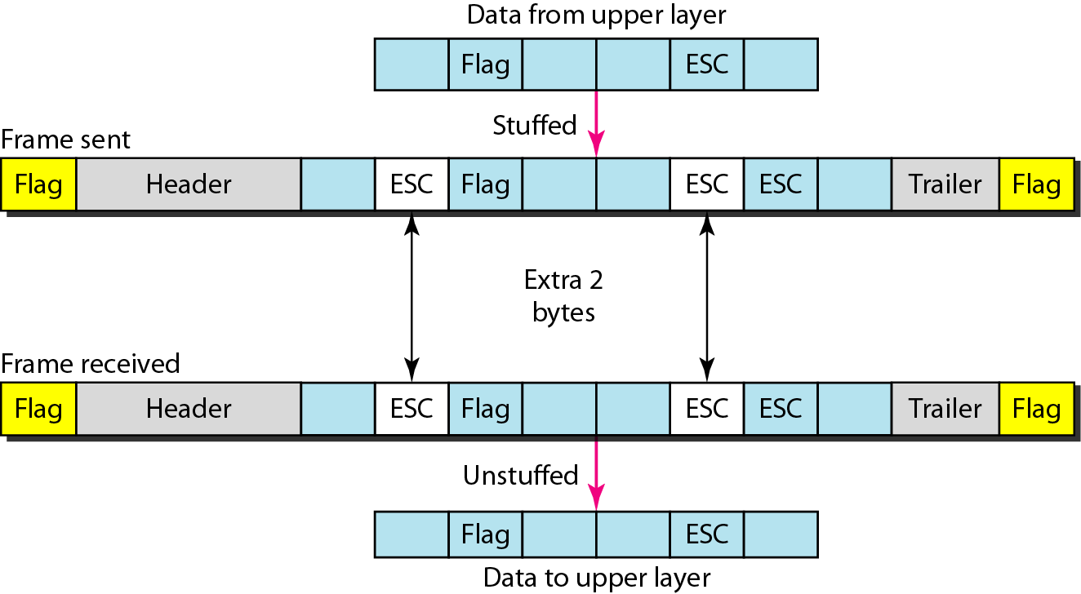
Byte stuffing and unstuffing

Slide 10

Note
Byte stuffing is the process of adding 1 extra byte whenever there is a flag or escape character in the text.

Slide 11
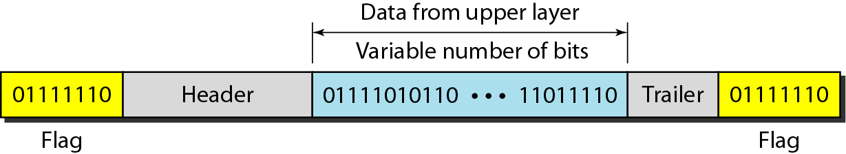
A frame in a bit-oriented protocol

Slide 12
Note
Bit stuffing is the process of adding one extra 0 whenever five consecutive 1s follow a 0 in the data, so that the receiver does not mistake
the pattern 0111110 for a flag.

Slide 13
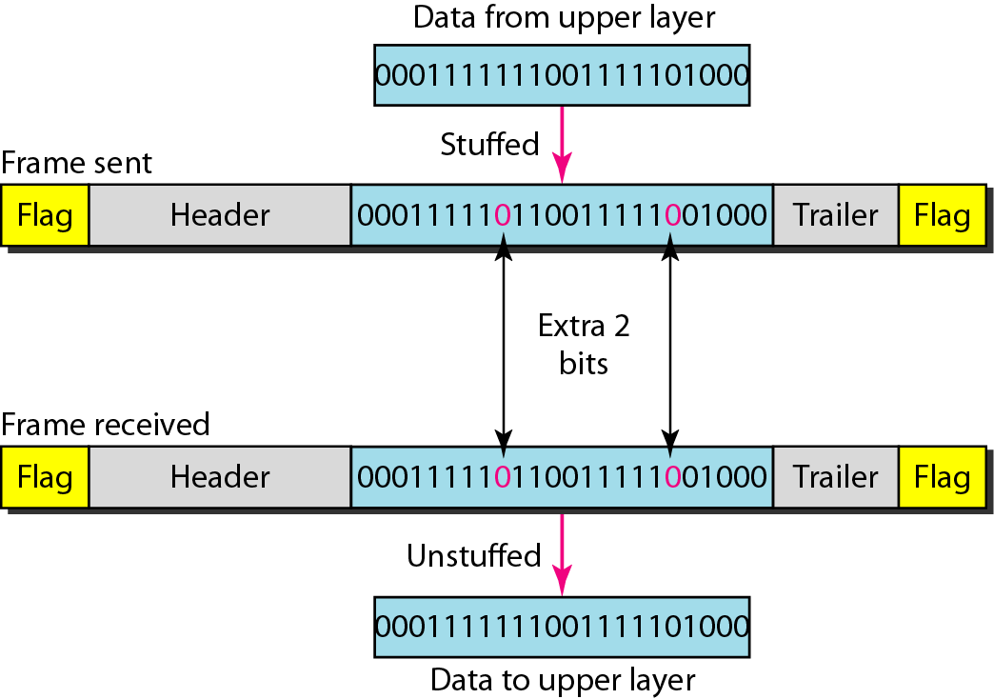
Bit stuffing and unstuffing

Slide 14
FLOW AND ERROR CONTROL
The most important responsibilities of the data link layer are flow control and error control. Collectively, these functions are known as data link control.
Topics discussed in this section:
Flow Control Error Control

Slide 15
Note
Flow control refers to a set of procedures used to restrict the amount of data
that the sender can send before
waiting for acknowledgment.

Slide 16
Error control in the data link layer is based on automatic repeat request, which is the retransmission of data.
Corrupted frame
Method 1 - discarded
Method 2 - Ack sent for accepted frame alone

Slide 17
DLC PROTOCOLS
Connection less
frames not numbered, non relationship betweeen them
Connection oriented
frames numbered, ordered before delivering to network layer

Slide 18
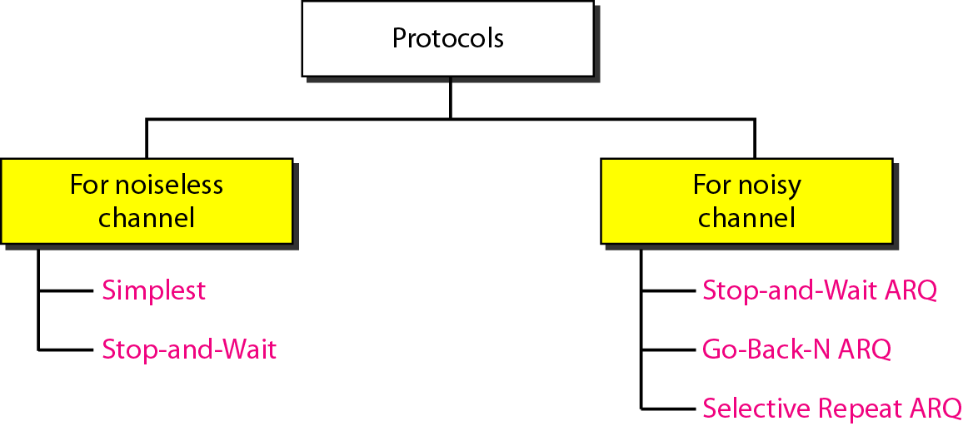
Taxonomy of protocols discussed in this chapter

Slide 19
Finite State Machine (FSM)
An FSM - finite number of states.
The machine is always in one of the states until an event occurs.
Each event is associated with two reactions: defining the list (possibly empty) of actions to be performed and determining the next state (which can be the same as the current state).

Slide 21
Simple Protocol

Slide 22
Simple Protocol

Slide 24
FSM for Stop and Wait Protocol

Slide 25
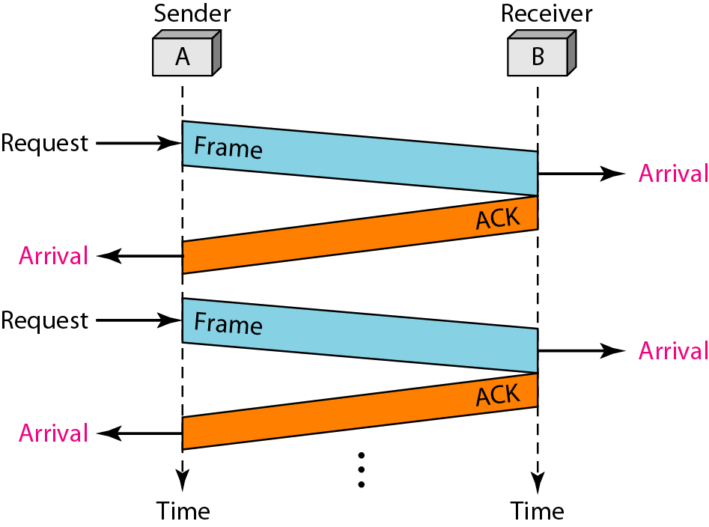
Flow diagram

Slide 27
Piggybacking
Data in one direction is piggybacked with the acknowledgment in the other direction.
When node A is sending data to node B, Node A also acknowledges the data received from node B.

Slide 28
HDLC
High-level Data Link Control (HDLC) is a bit-oriented protocol for communication over point-to-point and multipoint links. It implements the ARQ mechanisms we discussed in this chapter.
Topics discussed in this section:
Configurations and Transfer Modes Frames Control Field

Slide 29
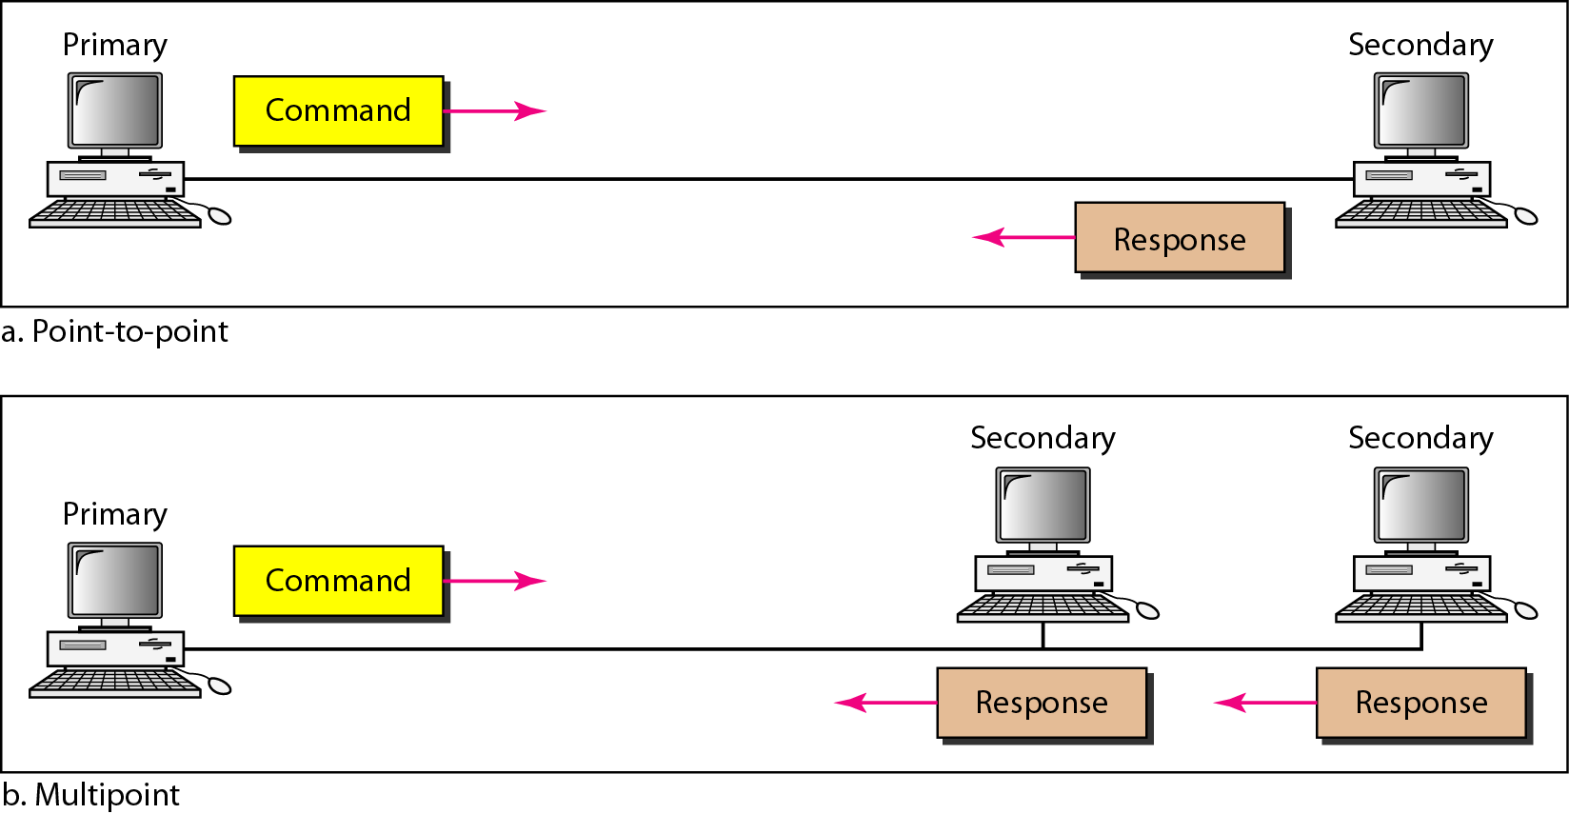
Normal response mode

Slide 30
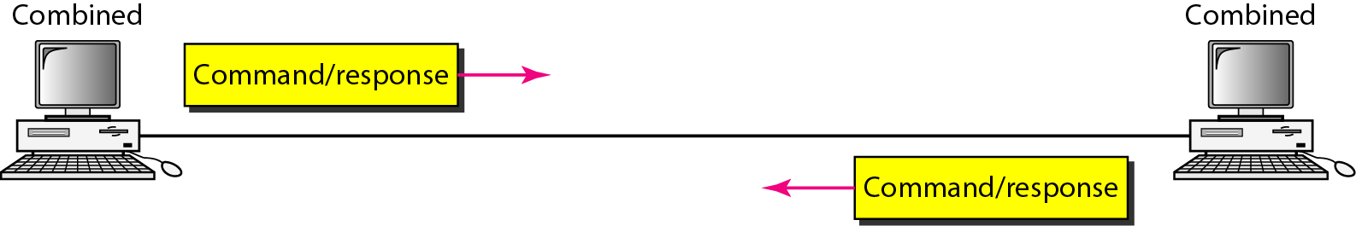
Asynchronous balanced mode

Slide 31
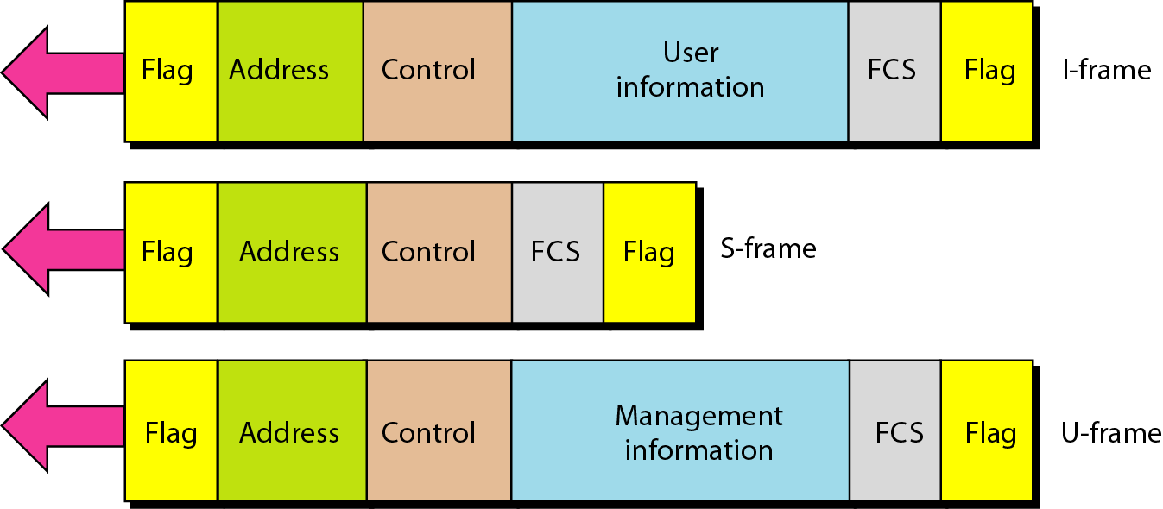
HDLC frames
User data
Transport control info
reserved for system mgmt ie., link

Slide 32
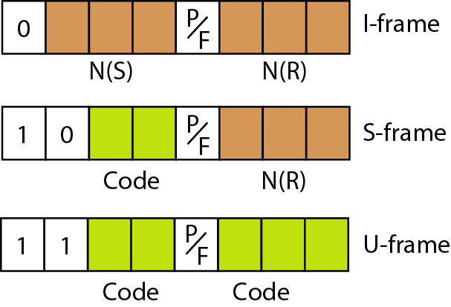
Control field format for the different frame types
1 , poll -primary to sec - add - receiver address
1 , final - sec to pri - add - sender address

Slide 33
Control field of S frame
00 -Receive ready
10 -Receive not ready
01- Reject NAK - go back N ARQ
11 - selective reject

Slide 34
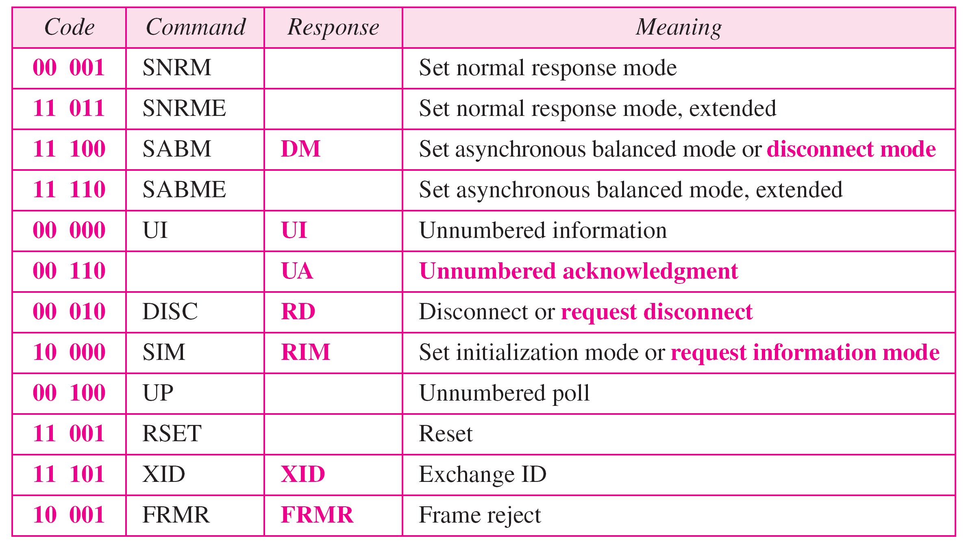
U-frame control command and response

Slide 35
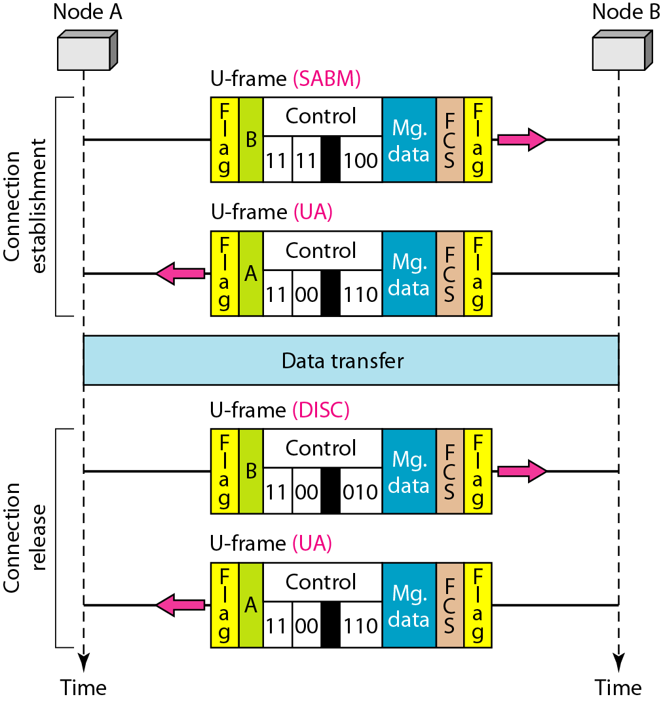
Example of connection and disconnection

Slide 36
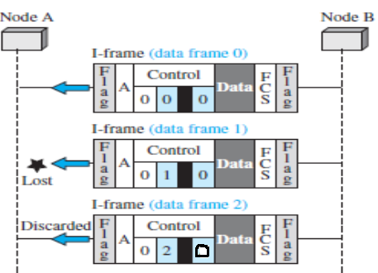
Example of piggybacking without error
Example of piggybacking with error

Slide 37
Outcomes
Students will be able to explain about
Data Link protocols - Simple and Stop and Wait Protocol
Byte and Bit Oriented Protocol
High Data Link Control Protocol

Slide 38
Test Your Understanding
If data is 10101011110111111010, the received data would be _____________________ using bit oriented protocol.
S frame is used to transmit ____________ information

Slide 39
THANK YOU

